Slide 1

Exploring Pathways to RiC Implementation
2022 SAA RESEARCH FORUM
Notes:
Good afternoon and thank you for joining us today. My name is Anna Björnsson McCormick and my colleague Elizabeth Russey Roke and I are presenting on our groups research into and experimentation with Records in Context

Slide 2
Who are we?
Elizabeth Russey Roke
Metadata and Discovery Archivist, Emory University
Anna Björnsson McCormick
Librarian for Arrangement and Description, New York University
Kelli Babcock
Digital Initiatives Librarian, University of Toronto
Greta Kuriger Suiter
Manuscripts Archivist, Ohio University
Regine Heberlein
Library IT Data Analyst, Princeton University
Ruth Kitchin Tillman
Sally W. Kalin Early Career Librarian for Technological Innovations, Penn State University
Notes:
We are an international group of archivists and librarians who work with archival data on a daily basis, my name is Anna and I’m the LFAAD at NYU, my co-presenter is Elizabeth Ruh-see Rok (long o), from Emory, and our group also includes
Re-GHEE-ne HEB-ber-line, Princeton
Greta SOOT-er, Ohio University
Kelli Babcock, U of Toronto
And Ruth Kitchin Tillman of Penn State

Slide 3
Background
Our group met and began working together during the IMLS funded Lighting the Way Working Meeting
We were grouped together because we all expressed an interest in linked data
We wrote “The Power of Parallel Description: Wikidata and Archival Discovery”
During this process we solidified our view that linked data must be done in a pragmatic way
We found the Lighting the Way format helpful for collaborative research and continue to meet to discuss ways to incorporate linked data in an archives setting
Notes:
We began working together as a group during the Working Meeting phase of the IMLS funded Lighting the Way project on archival discovery and delivery. Participants were separated into groups based on their stated interests and the six of us had all expressed an interest in using linked data to enhance discovery of our collections. In this setting we focused on Wikidata and wrote a paper titled “the power of parallel description: wikidata and archival discovery” which was included in the “The Lighting the Way Handbook: Case Studies, Guidelines, and Emergent Futures for Archival Discovery and Delivery.” During this project it became clear that in addition to a general interest in linked data, we all found it important to take a pragmatic approach to linked data implementation and wanted to determine what actions we could actually put into practice considering our regular job duties, state of our archival data,and other practical considerations. After the LTW project concluded we stayed in touch and decided to explore other ways of implementing linked data.

Slide 4

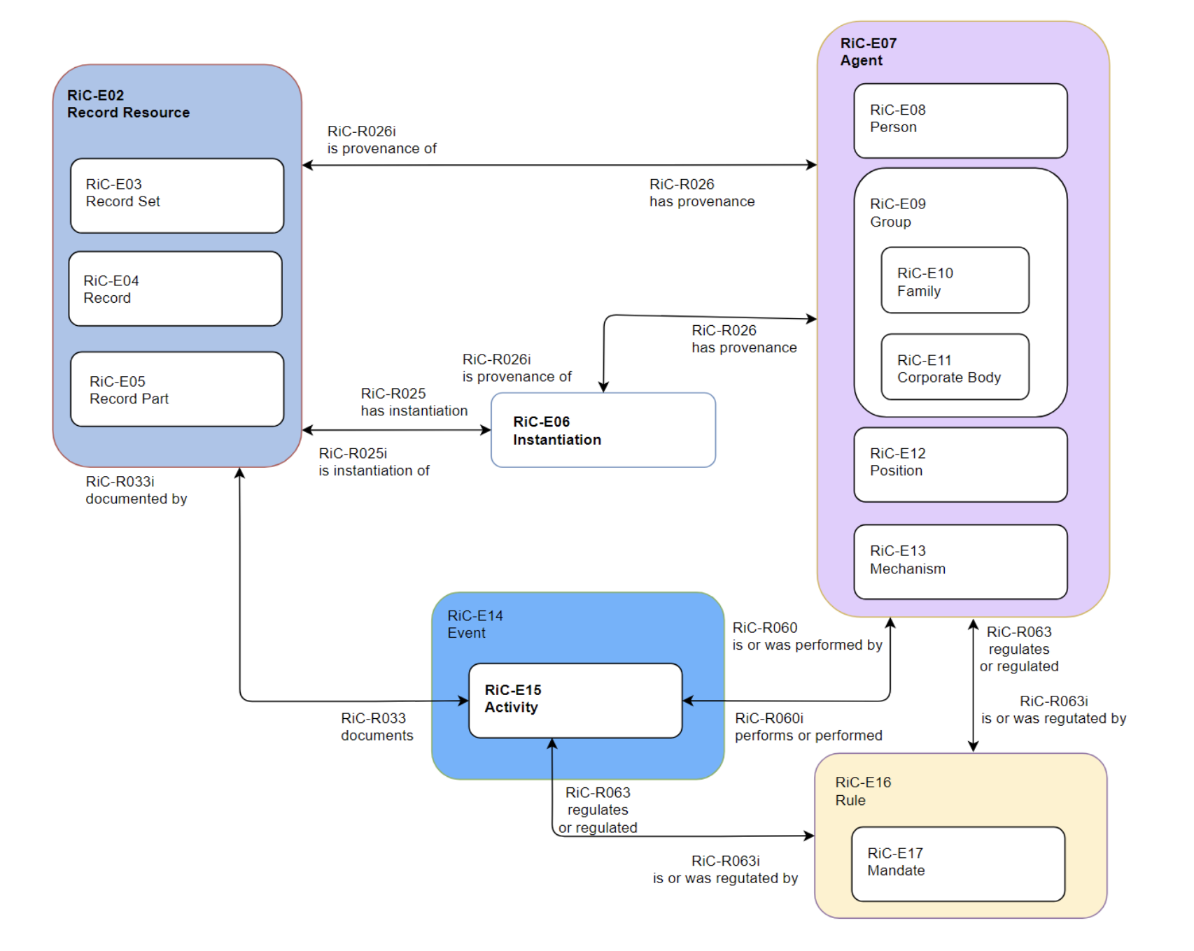
Records in Context (RiC)
Conceptual model and associated ontology that harmonizes the four ICA description standards:
ISAD(G)
ISAAR(CPF)
ISDF
ISDIAH
106 classes; 238 core object properties
Conceptual model: https://www.ica.org/en/records-in-contexts-conceptual-model
Ontology: https://github.com/ICA-EGAD/RiC-O
Notes:
Eventually this lead us to exploring Records in Context, a conceptual model for describing records with semantic triples developed by the International Council on Archives. As of 2022, ICA has published a conceptual model, an introduction to archival description, and an ontology for RiC. The overall goal of RiC is to harmonize the following ICA description standards:
ISAD(G): General International Standard Archival Description, analogous to DACS
ISAAR(CPF): International Standard Archival Authority Record For Corporate Bodies, Persons and Families
ISDF: International Standard for Describing Functions
ISDIAH: International Standard for Describing Institutions with Archival Holdings

Slide 5
Transition to RiC
Changes in standards require careful planning and resourcing:
To assess the feasibility of transitioning
To account for impacts on current and future labor
To reconfigure systems
To build knowledge and support for the new standard
The bottom line: What does RiC offer? How do we get there? What is the cost/benefit?
Notes:
As a group we aimed to think through a potential transition to RiC as description standard. We know changes in standards require resources and detailed planning and we wanted to To assess the feasibility of transitioning to RiC, account for the labor necessary to make such a transition, and to think about how systems may need to be reconfigured. Ultimately our goal was to work towards answers to questions such as What does RiC offer? How could we make the transition? What are the costs and benefits of a potential transition?

Slide 6
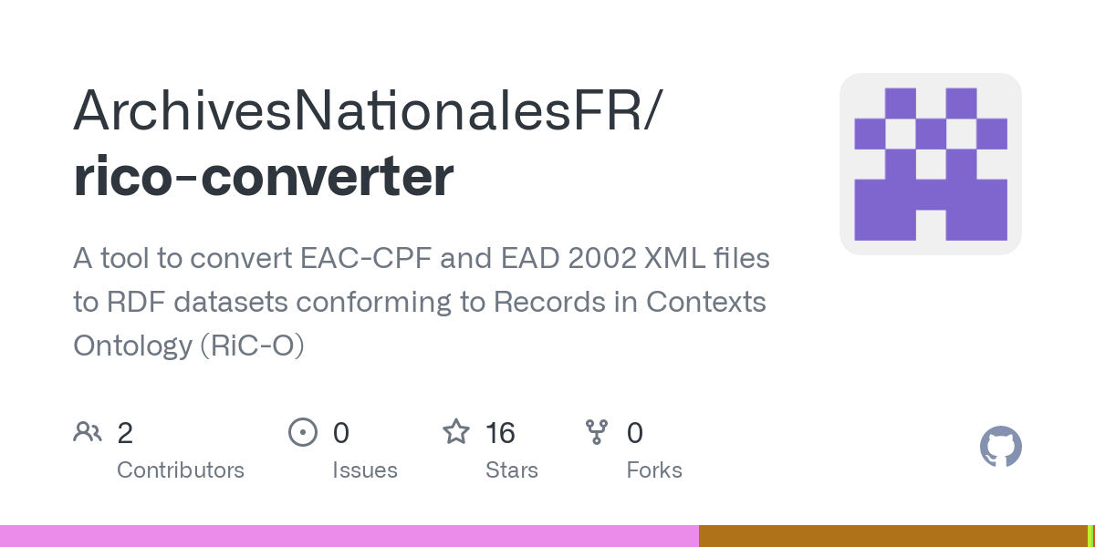
Convert sample EAD files to RiC-O
EAD exported from ArchivesSpace: Penn State, Princeton, New York University
AToM EAD export: University of Toronto
Native EAD files: Emory
https://github.com/ArchivesNationalesFR/rico-converter
Notes:
Our project thus far has been focused on getting to know RiC. With 106 classes and over 238 core properties it has been difficult to figure out where to start. We read documentation and even tried modeling from scratch, but that proved to be overwhelming. The most effective thing we've found for exploring RiC has been a script developed by the National Archives of France. This script converts EAD 2002 XML files to RiC. That gave us a chance to see how our own data, which we knew intimately well, would look like.
As those of you who work with XML can probably guess, it took a little bit of tinkering to make the script work. Namespace declarations were especially fun. In the end, though, we produced a sample set of records from each of our institutions. Three of us are from institutions that use ArchivesSpace natively; one uses AToM; and one uses a homegrown system with EAD records encoded by hand. That gave us a wide variety of probable scenarios that we could compare and contrast.

Slide 7
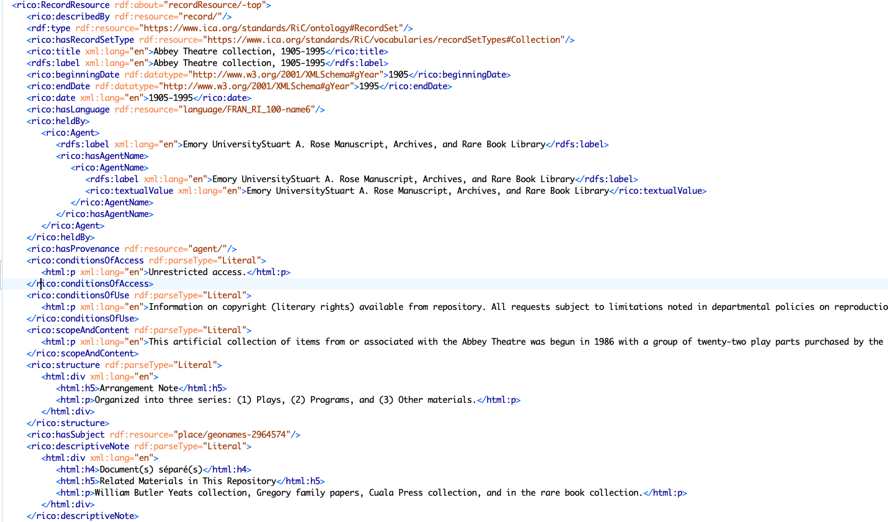
Notes:
And here's what a snippet of one of those converted files looks like. We noticed a couple of things. First, because this script was developed for the National Archives of France, the script tends to make assumptions. You can see this in this snippet where it applies a local language declaration (assumed to be French) and the missing provenance information, which probably is in a different field than the script expects. We also noticed that the script assumes much of the data is a literal or text-based. You can see that in conditionsOfAccess, the ScopeAndContent note, and the Arrangement note. This makes sense, of course, since metadata in these and many other EAD fields tends to be textual notes, but it was striking to us how much of the RDF conversion process resulted in data that didn't look much different than the original EAD XML file.
For those who record identifiers from SNAC, NACO, and other controlled vocabularies, those are represented as URIs and enabled the script to produce better RDF data. You can see that here in the geographic subject. Unfortunately, most of the records we tested didn't record identifiers beyond creator names and subject headings, which I suspect is the case for most of us. While this is in part due to the design of our systems, it limits what can be done in a conversion such as this one and results in a text-heavy, rather than an interlinked output.

Slide 8
Histories are framed as literals rather than structured series of events.
Histories can be found within events.
rico:
RecordResource
rico:has
EventType
rico:Event
rico:
hasOrHad
Subevent
rico:Event
rico:is
AssociatedWithDate
rico:history
rico:EventType
rico:history
rico:history
Date
Literal
Literal
Literal
Notes:
The tendency of the script to output textual notes rather than interlinked data was especially evident with provenance data and the custodial history. Textual notes are generally how provenance is structured in EAD. However, one of the benefits of RDF is the ability to capture more nuance. The example on the right where an event has an associated subevent, possibly with different agents and dates, illustrates what is possible with RDF. While RiC has classes and properties to model event data in this way, it was interesting that the script basically reproduced the EAD structure. This suggests that there will be limits to how much we can achieve if we only rely on conversions from existing EAD-based data.

Slide 9
Preliminary observations
Scripts are not a magic solution!
Much of our archival description does not translate to meaningful RDF without significant intervention.
EAD is heavily text-based (i.e. scope notes, historical notes, folder titles, etc.)
Lack of entities/URIs/identifiers in source data results in stringed RDF.
See also Archives and Special Collections Linked Data: Navigating between Notes and Nodes
We all use standards differently, even within systems such as ASpace.
Notes:
So some preliminary observations. Scripts are not a magic solution. Any conversion from EAD-based records and systems to RiC will require significant retooling and possible human intervention. Much of our archival description does not translate to meaningful RDF, as we saw with the event modeling. Our current data will need to be enriched to be able to do more than simply reproduce EAD in another format. This might include adding more identifiers to our data, uniquely identifying entities in our container lists and notes fields, and thinking of our archival description as structured data rather than a linear finding aid. Finally, and I can't emphasize this enough, our experiments with converting our data to RiC showed that each of our institutions output varied. The relative openness of archival standards means that interlinking data, whether it be in EAD, RDF, or something else, will continue to be a challenge.

Slide 10
Future work and research
Development of use cases for RDF-based data in archives
Gaining a deeper understanding of where current data could be enhanced to take advantage of graph-based data structures.
Determining which conversions are scriptable...and which aren't
Mappings to/from RiC-O to existing archival systems
Notes:
Today's presentation only represents the beginning of our project. We plan to continue to explore what a transition to RiC might mean for our current systems and practices. This includes the development of use cases for RDF-based data in archives, gaining a deeper understanding of where we need to enhance our existing data, determining where conversion scripts could make this transition easier, and exploring mappings to existing archival systems such as ArchivesSpace and AToM.
As many of us remember from EAD, adoption of a new standard requires years of work. Reaching the current implementation level we have in 2022 (version 1 of the standard was released in 1998) meant the development of long-standing workshops, a “cookbook” for data modeling, the creation of an SAA roundtable dedicated to EAD, and even archivist-created websites, such as EADiva, that offered additional support to new users.
We expect that any transition to RiC will require a similar effort that concentrates resources not just on systems and tooling but also the social communities and working groups that support users and encourage widespread adoption.

Slide 11
Thank you!
Our sample RiC outputs can be found at https://github.com/Linked-Archival-Data/pathways-to-RiC
Elizabeth Russey Roke - erussey@emory.edu
Anna Björnsson McCormick - anna.mccormick@nyu.edu
Ruth Kitchin Tillman - rkt6@psu.edu
Greta Kuriger Suiter - suiter@ohio.edu
Regine Heberlein - heberlei@princeton.edu
Kelli Babcock - kelli.babcock@utoronto.ca
Notes:
If you're interested in seeing more of our sample RiC outputs, they are available in a github repository linked here. We also plan to continue to document our work there if you're interested in following our progress. Thanks for your attention!

